Slide 1

How to re-engage young people with education/learning?
12th November 2020 – YANQ Forum presentation

Slide 2

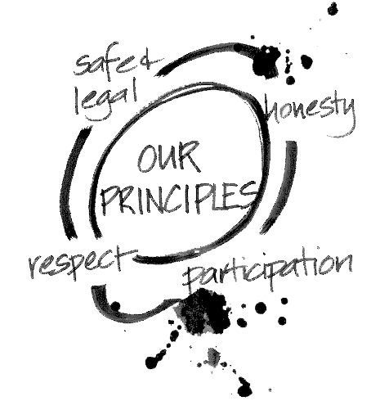
Thank you for the invitation to talk to you today: I know I am talking to a zoom full of very experienced practitioners who any number of you could easily be doing this presentation. Acknowledge that 2020 has been a strange year and one where all of us that work with vulnerable young people have seen disengagement at its highest levels. I can only talk to you about my experiences and hope that 1 or 2 things resonate with you today. Who am I, What’s my lense EREA – Edmund Rice Education Australia – 22 years 22 Special Assistance Schools across Australia ( growing area in education) Operation by Principles -+ Common ground Head of Campus of Deception Bay Flexible Learning Centre for 5 years National role with 6 Principals of EREAFSN – www.ereafsn.edu.au

Slide 3
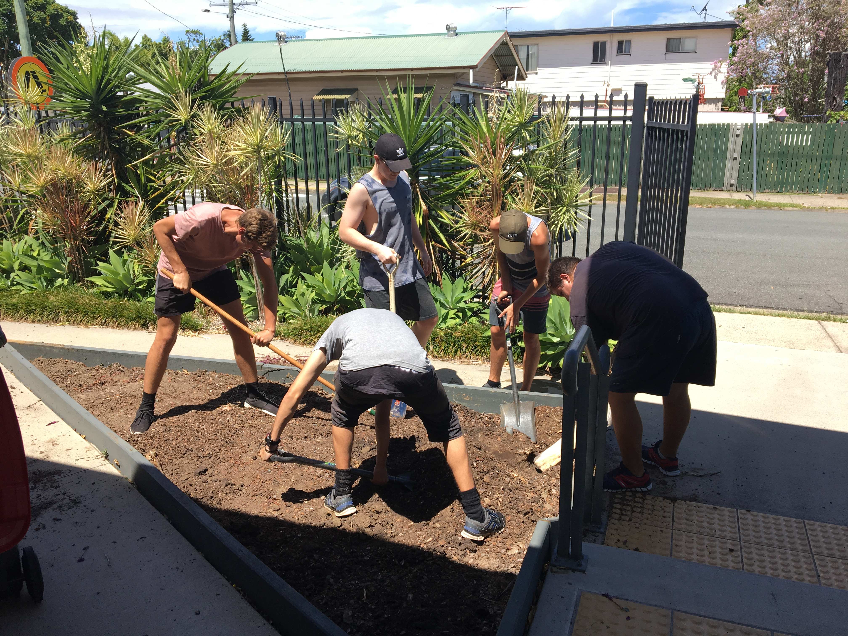
How to engage Disengaged YP
Highly Disengaged YP (those that you call, haven’t been at school for ages,
who keep promising to come in but don’t, YP that you're working with eg YJ, GO)
We can’t wait for YP to come to us we need to go to them…
What does this look like:
Home Visits- parcels of food…sitting in conversation with the YP, family/carers
Meeting at a local McDonalds or Park (food is a massive connector for YP)
The focus of these visits is on wellbeing, support, building up trust
This may take a while and we may need to take small steps…..once a week, twice a week
We need to find out what the YP UNMET NEED
Once we LISTEN and we have the YP Need on the Table
then we can Collaborate to work on a solution together
FLEXI – refer to this as CPS – Collaborative Problem Solving (thinkkids.org)
Resource: https://www.youtube.com/watch?v=ygMWv9VesiQ
Your school/community needs to develop systems and processes to be able to reach out to YP.

Slide 4

COVID has shown us that some YP can thrive working from home to allow them to be carer’s for their family, or take better care of their own mental health needs…. IN QLD this does not meet school registration guidelines, but I think we need to continue to challenge and advocate for YP because this is a valid engagement method which is really beneficial for some of our YP.
At the end of day sometimes if we can not engage a YP to come to our school then we must say goodbye – this is sad and challenging for us, but it can be the vehicle for Young People choosing to re-engage. We are a school and need to meet our CENSUS guidelines and this is something we need to be upfront about with YP.
What’s important:
They know the door is always open
We continue to connect in regarding their wellbeing
We work to establish other agencies/schools to support the family and the YP needs.

Slide 5
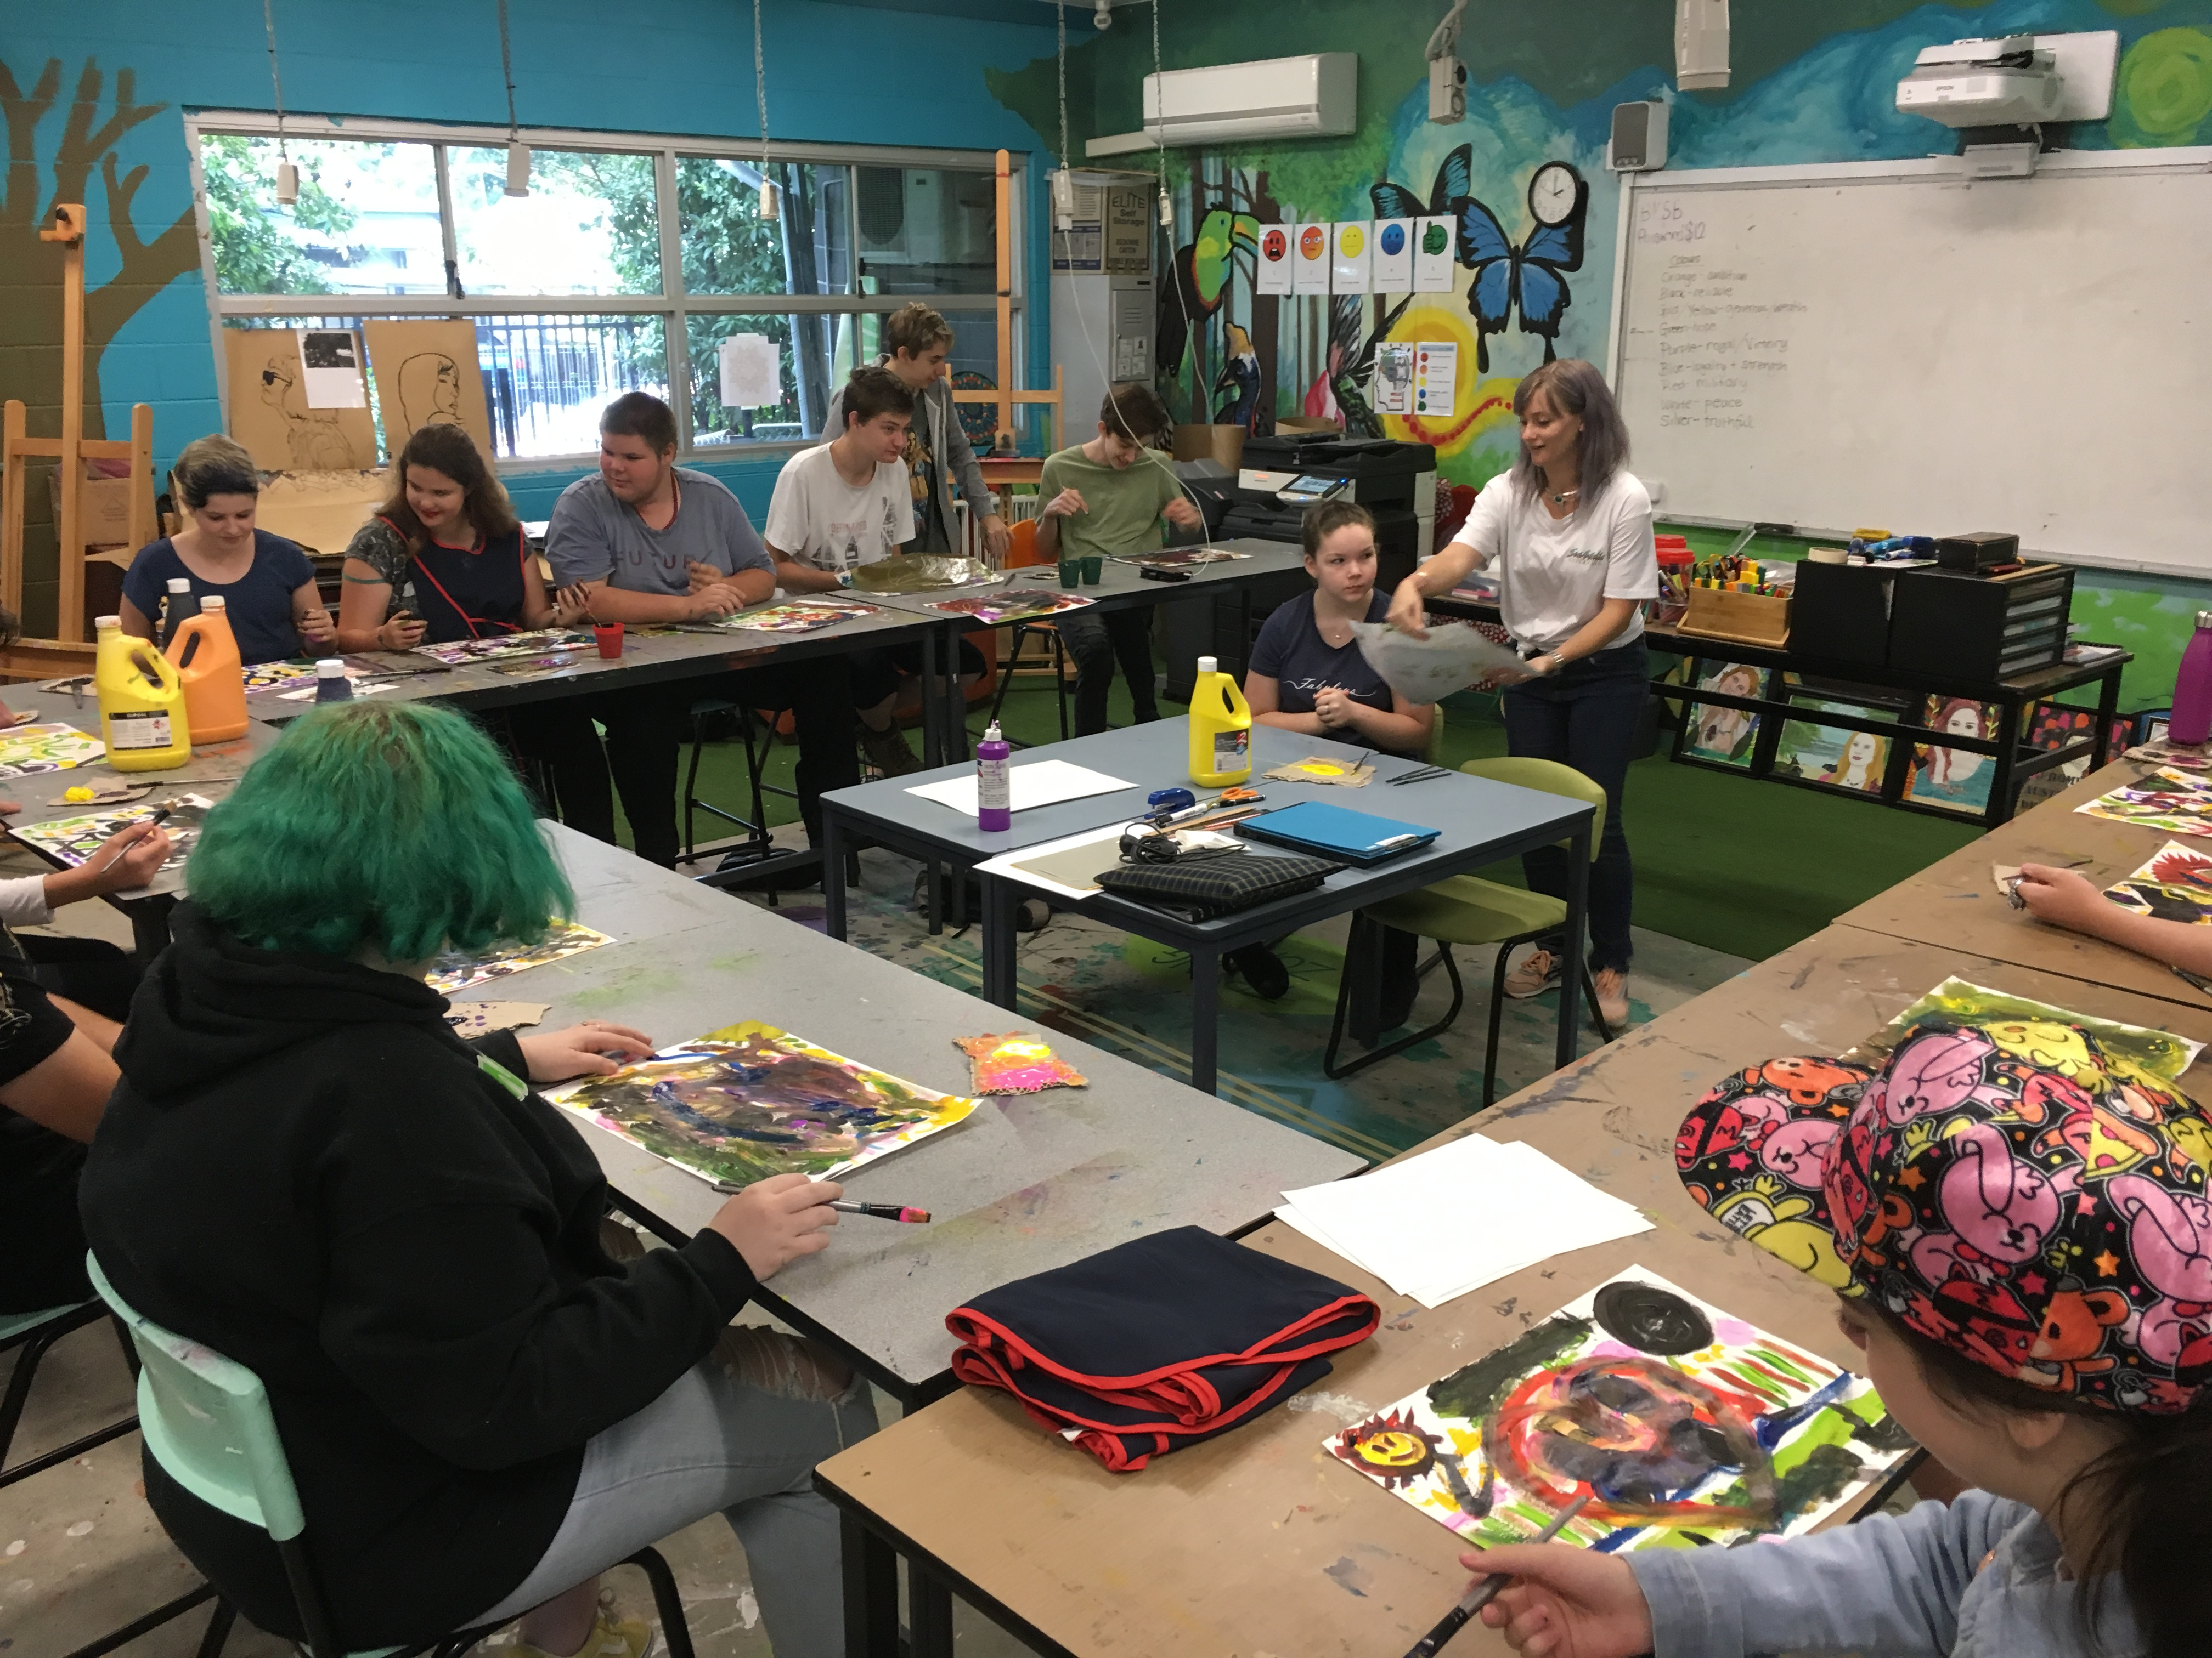
So How do we engage YP who do come to our schools/communities
and what’s the key to keeping them engaged:
Visually make your school or community a safe space
Colours and images make places feel welcoming… messaging your using
Culturally Safe – local language and images – working with elders- developing a RAP or IES,
LGBTIQ+ - rainbow flag….
Mental health – R U OK…posters. Be YOU etc.
4 Principles (values) are everywhere…..
TIP practice framework eg REBOOT or BERRY ST

Slide 6
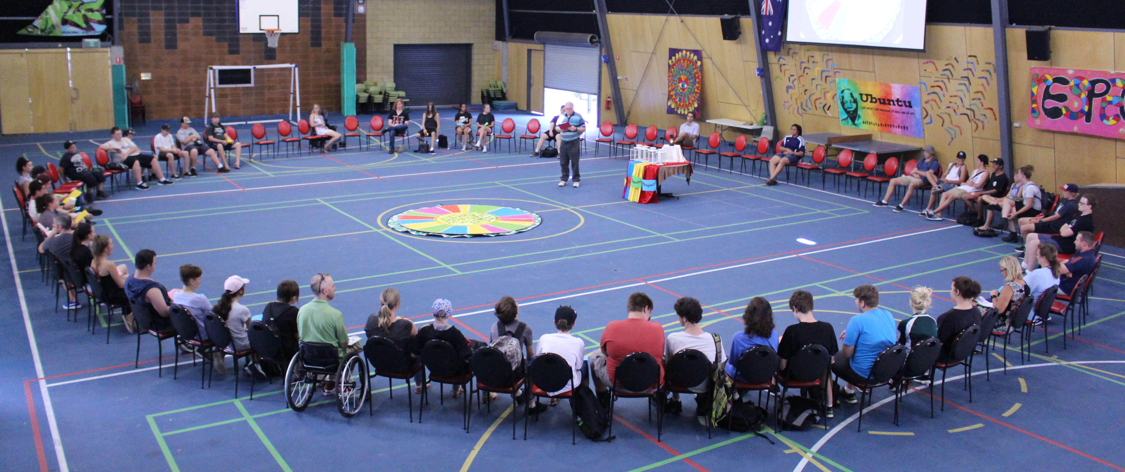
Know the YP and their story : RELATIONSHIPS, RELATIONSHIPS, RELATIONSHIPS
Greet by name,bump elbows (covid style)
Show unconditional positive regard – that is be there for them without judgement – what we do and say matters enormously…..….. this requires deliberate staff PD and practice meetings with scenarios – because under pressure when a YP is escalating staff need to know what to do and as a site we need to be consistent and predictable in our approach… this is what makes YP feel safe and then they will engage in learning.
Acknowledge from enrolment that YP are the expert of their own lives and that we are here to support and guide them… seems simple but empowers a young person greatly.

Slide 7
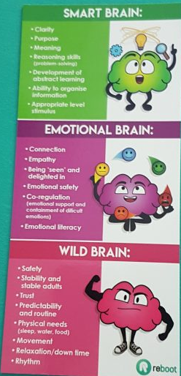
Have a robust induction program that focuses on:
how the brain works (reboot image) and Trauma Informed Practice
Demonstrate who you say you are:
If we say we respect young people make sure this is evident, be inclusive, gender neutral
language, culturally safe resources
2. Participation – (have lunch together, build in brain breaks, allow them to participate in
a variety of ways,and acknowledge that it is okay not to participate yet.
3. Set high expectations regarding attendance and let them know that we are not a drop-in
center – we have accredited and non accredited learning, but we do it differently. YP choose their timetable and can negotiate their learning… ask them what they have always wanted to learn or know about.
Home visits
Establish Wellbeing plans - who can a YP go to, what helps them de-escalate… (Visual)
Have Personal Learning Plans and involve the YP/family/carer as soon as possible. GOALS

Slide 8
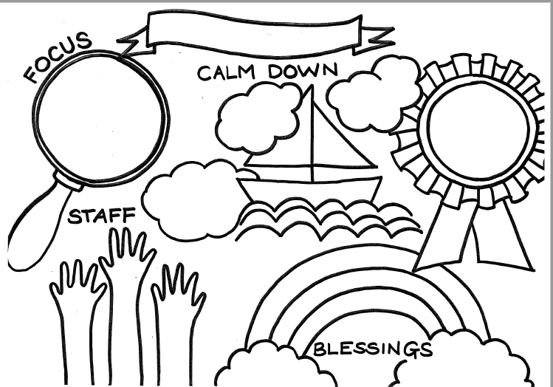
Wellbeing Plan Wellbeing Tracker
https://forms.office.com/Pages/ShareFormPage.aspx?id=1C4T-gF4SUyIc2UK4tXCtvsfdg7gRXlCnLARq-in1gFUNUU2QUo0WFYzN0pEWVZTRFFIWldXOTNFOS4u&sharetoken=12mBSxPdTYnemEJyCtx1

Slide 9
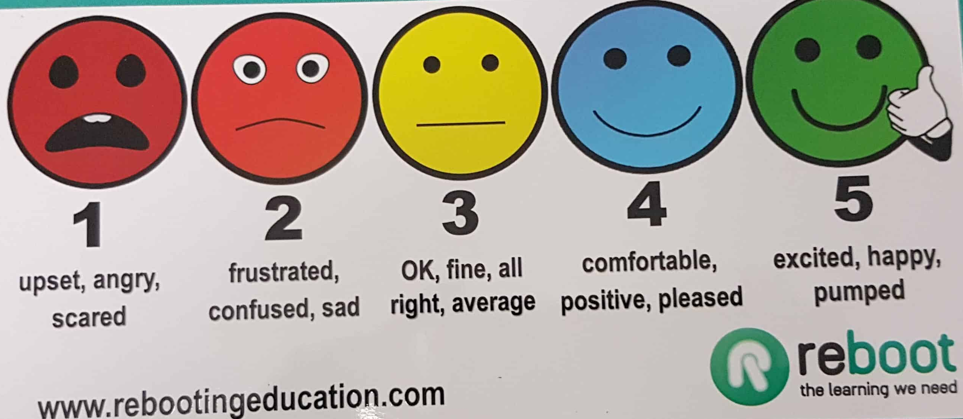
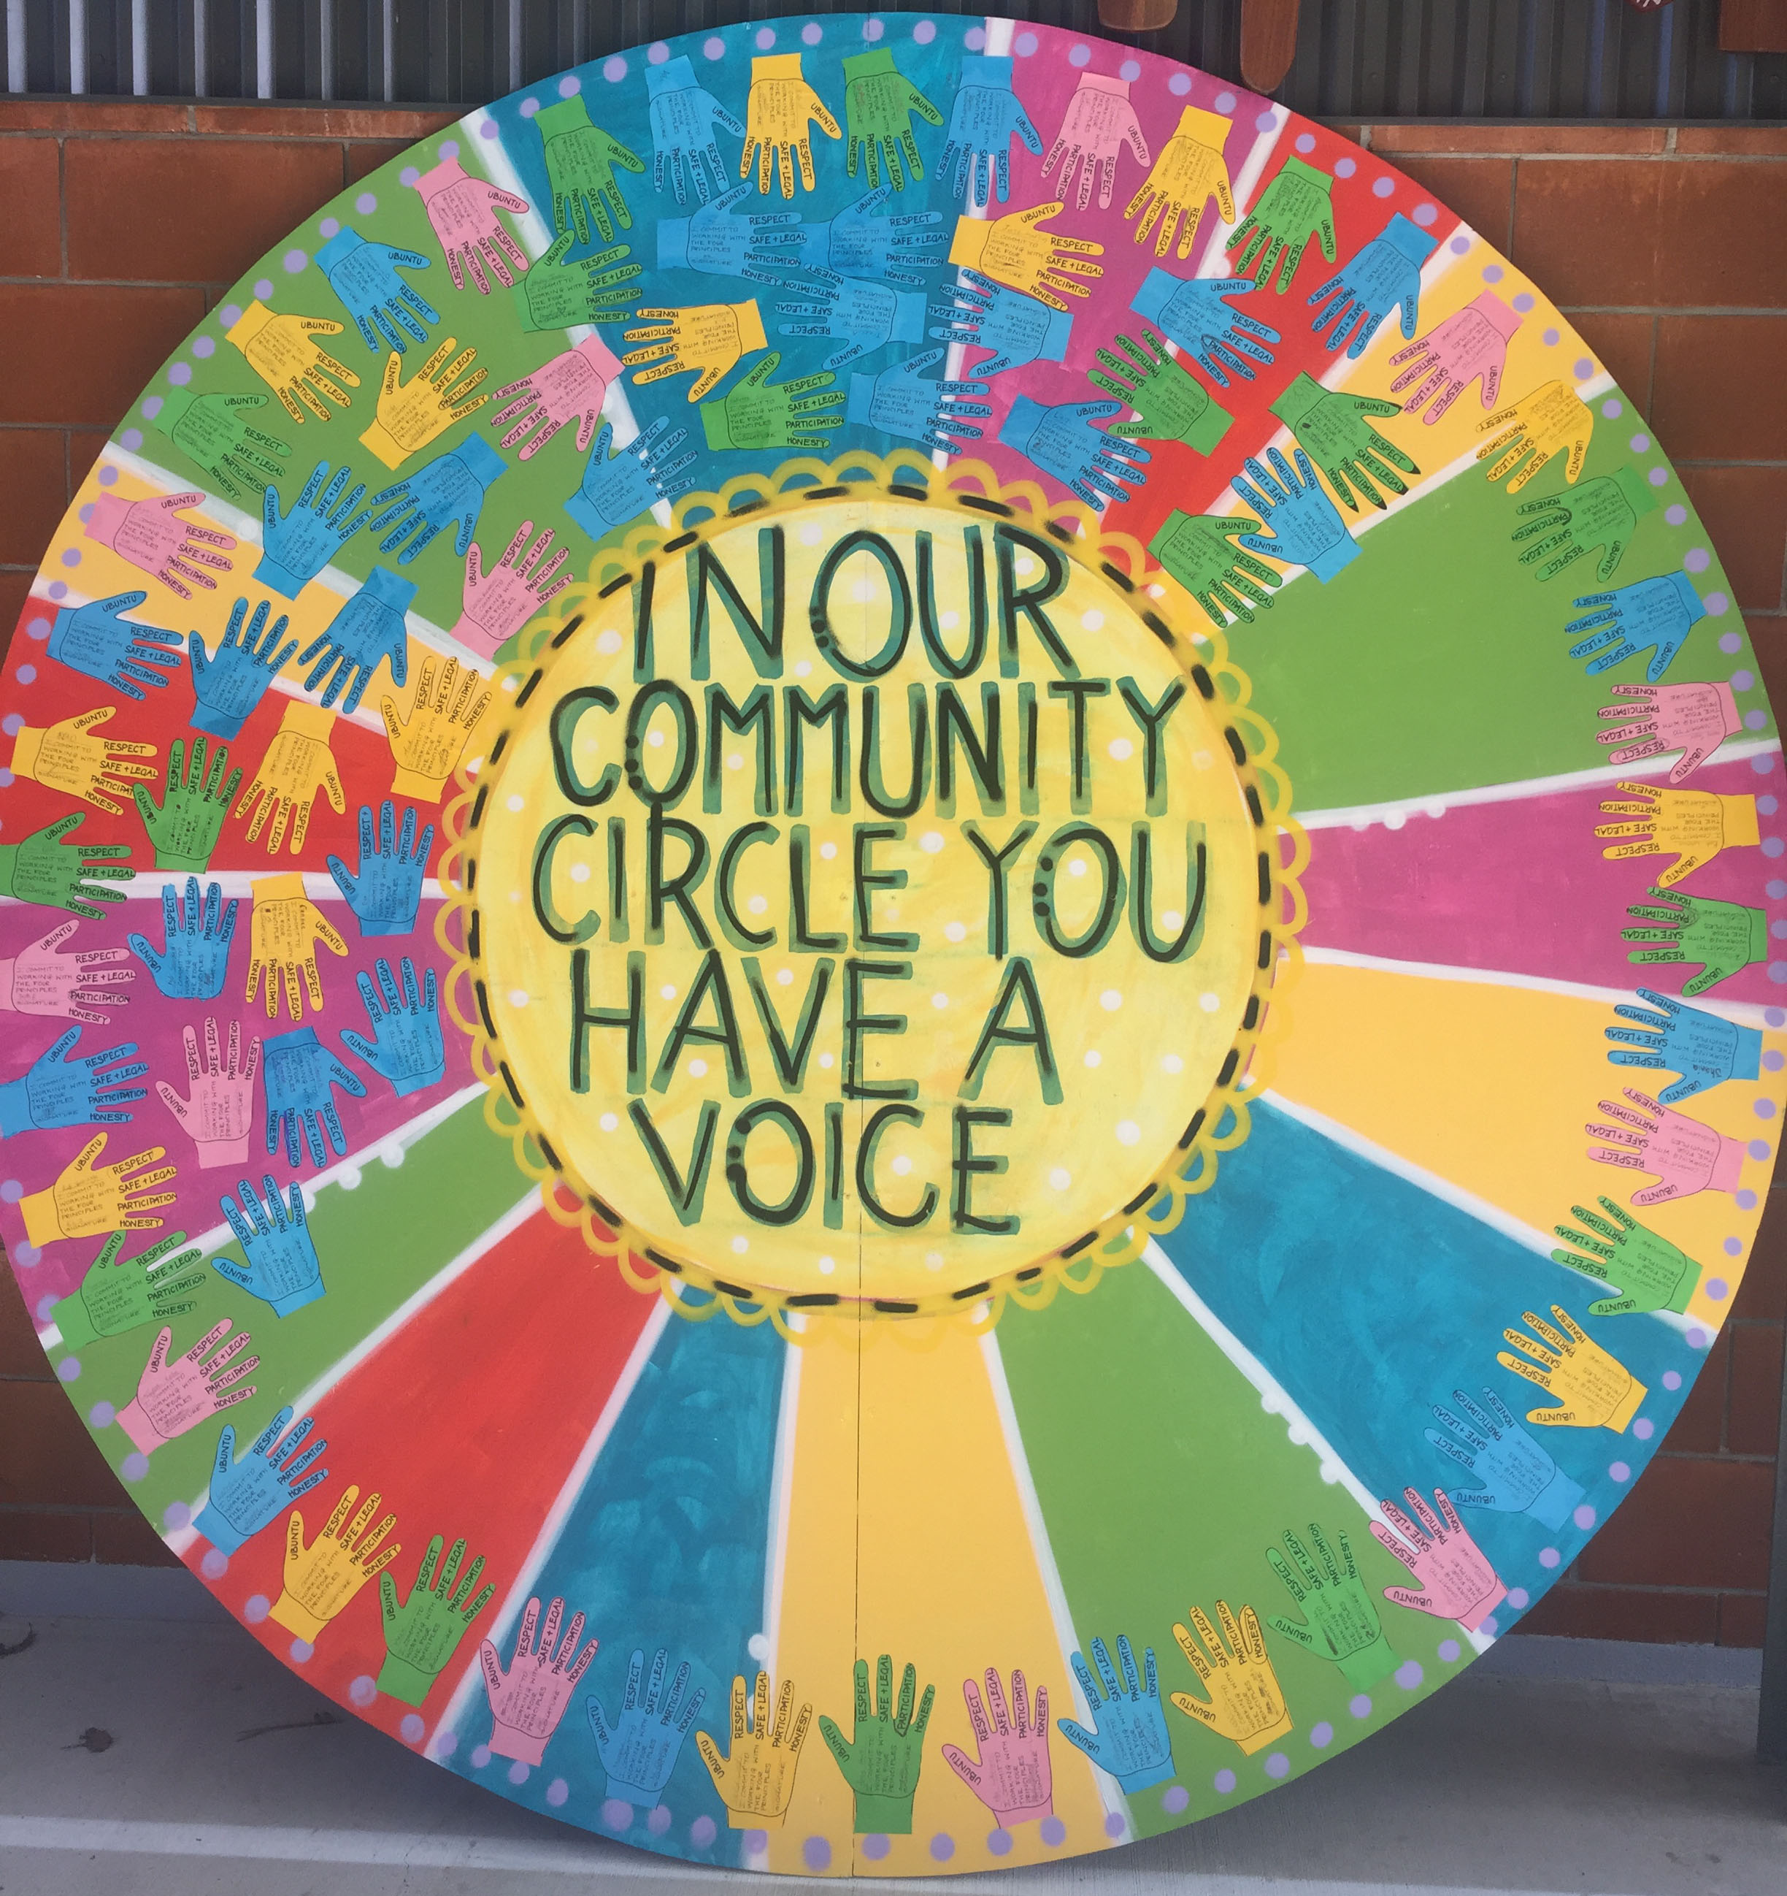
4 . Build in student voice – morning meetings and pastoral care groups
lead by YP
where all yp and staff sit in a circle in a Morning meeting
We talk about what’s happening in the world as well as what are the issues at school.
Celebrate the good things – shout out’s are encouraged – by YP to YP, staff to YP
We acknowledge birthdays, academic success, work experience etc
Check in – 1- 5 (Reboot) – climate of our school, and teaching YP empathy.
Physical hands up/pen – ready to engage with the 4 Principles and therefore learning

Slide 10
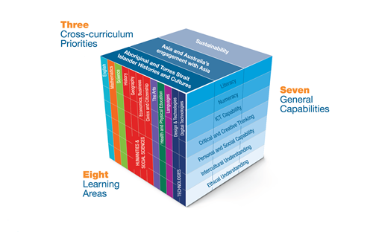
Capitalise on young people interests and make their interests fit your learning framework -
Student voice in co-designing learning:
Use Project Based learning in Art, Technology ICT, STEM and Workshop, Music…
Build a YP sense of curiosity – Develop Curriculum that is underpinned by a STOP and THINK ? philosopy
This is where we teach our YP to negotiate and build their sense of agency and voice and build their dispositions…
Use Board and Talking stick games to help YP develop communication skills
When developing your curriculum :
Start with what type of YP you want to transition or graduate from your school. - Back map these…to your context, General Capabilities and 21st Century skills and Cross Curriculum Priorities

Slide 11

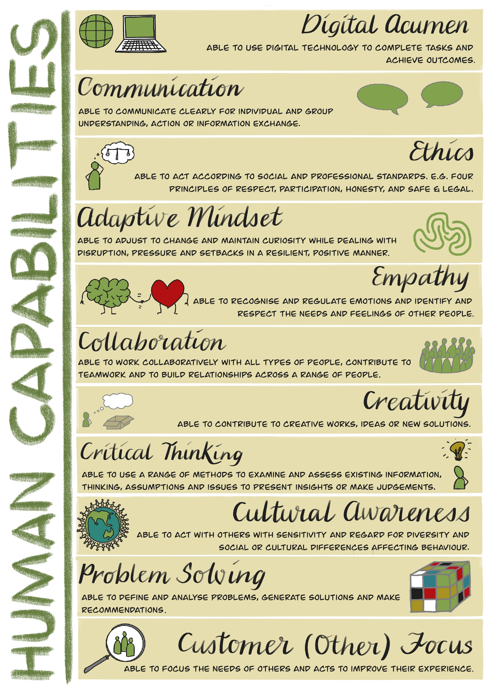
Area for GROWTH for us is rethinking about how we report on YP learning…
We are exploring developing learner profiles that capture the skills YP bring in ( cultural awareness – schools % of first nations-as well as the accredited learning they) We are investigating how we can help YP develop the language and skills needed for this ever-changing world –
In our QLD Flexi’s We have identified 11 areas that we would like to explore… and are looking at what our current practices that YP are engaging in where they are growing in these skills

Slide 12
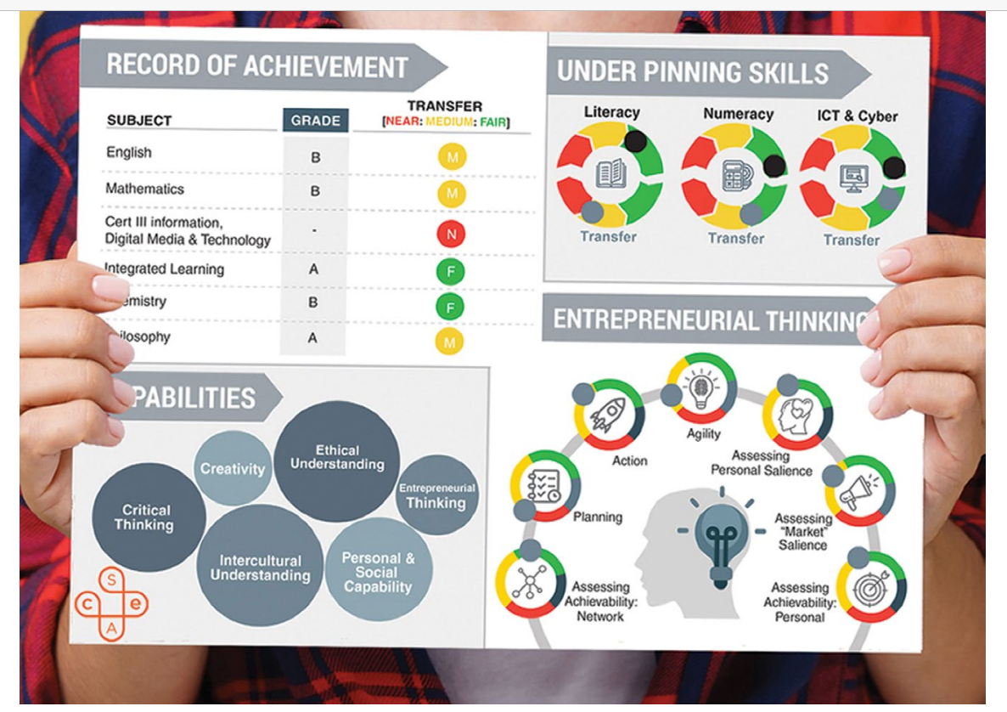
Beyond ATAR report: Provides some examples of what a Learner profile is. Our schools are exploring how we can broaden what we report on. We think this will help our YP understand their skills and help shape their areas of strength, and their ability to articulate and demonstrate soft skills … creating life- long learners
https://www.all-learning.org.au/sites/default/files/resources/beyond_atar_proposal_for_change_all.pdf

Slide 13
Finally – lets here from YP https://www.filmpond.com/ponds/ssle/films/9jTqrRVvAkaNp9Zn

