Slide 1
For more information, click here for a brief animation

Slide 2
This session:
Why youth engagement in education is a priority
What is the Youth Engagement Project?
Key initiatives of the Youth Engagement Project

Slide 3
Early school leavers slipping through
Too many early school leavers are disengaged – approximately 3,000 every year
Early leavers are 2.5 times more likely to be disengaged after school
Notes:
FlexiSpaces are one of the strategies in place to support schools to support at risk students to stay at school.
The Queensland school system is not broken. We have many achievements to be proud of. But there is room for us to do better for some of our students. The Next Steps Survey, for example, shows us that there are over 3,300 early school leavers who are not in study or work in the year after they leave school – and as you can see from this graph – the numbers of these disengaged students are growing.
These students have more than a one in three chance of failing to make a transition.
We know that staying on at school gives students the best chance of success.

Slide 4
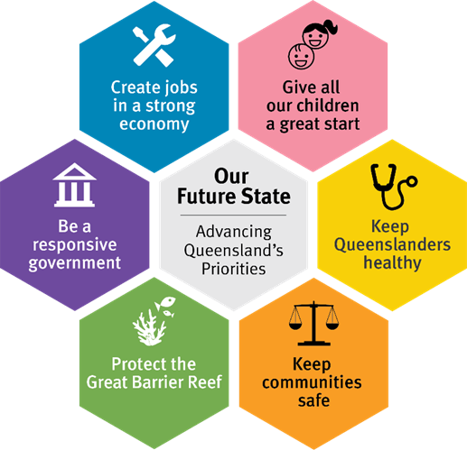
The Youth Engagement Strategy is supporting increased engagement in education, training and employment through a number of targeted initiatives
Supporting students to stay at school
Catching them if they fall
Strengthening the transition to further education and work
Supporting our schools
FlexiSpace*
Delivering a Digital Engagement Strategy*
Promoting high-quality alternative settings
Investing in Regional Youth Engagement Hubs*
Introducing Link and Launch*
Supporting our schools
Rolling-out FlexiSpace
Delivering a Digital Engagement Strategy
Promoting high-quality alternative settings
*Initiatives under the Advancing Queensland Priorities.

Slide 5
Lots of great things happening in schools
On our YouTube channel you can listen to Queensland state school Principals committed to youth engagement:

Slide 6
FlexiSpace
Designed to increase the number of young people who remain at school through:
High quality and targeted teaching and curriculum
High expectations for every student
Inclusive approach
High quality built environment
Multi-disciplinary approaches
Strong engagement with parents
Increased student agency
implemented as a tool for inclusive schooling
existing enrolments of the school
maintain access to the Australian Curriculum and eligibility for a Queensland Certificate of Education or equivalent
the location of the FlexiSpace is not isolated
a refurbished space, high quality and inclusive
high-quality, targeted teaching focused on reconnecting students and improving their outcomes
individualised plans with learning and wellbeing needs

Slide 7
FlexiSpace locations
Region | Current locations | Coming soon
Far North Queensland | Bentley Park College Mossman SHS | Gordonvale SHS Mareeba SHS
North Queensland | Charters Towers SHS Heatley SC William Ross SHS | Kirwan SHS Thuringowa SHS
Central Queensland | Glenmore SHS North Rockhampton SHS | Blackwater SHS Pioneer SHS
Darling Downs South West | Kingaroy SHS | Oakey SHS Toowoomba SHS
North Coast | Bundaberg North SHS Dakabin SHS Gympie SHS | Beerwah SHS Noosa District SHS North Lakes SC
Metropolitan | Bundamba SSC Michelton SHS | Earnshaw SC Whites Hill SC
South East | Flagstone SCC Mabel Park SHS Shailer Park SHS Upper Coomera SC | Beaudesert SHS Kingston SC

Slide 8
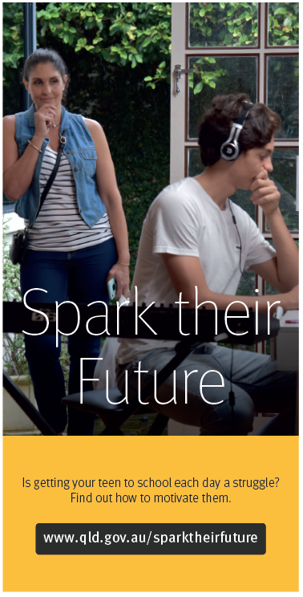
Digital Engagement Strategy
Subscribe for regular media kits at youthengagement@qed.qld.gov.au
Young people: to empower them to make the most of education, stay engaged, or find their way back in www.qld.gov.au/wethedifferents
Parents: to help them spot the signs of disengagement, strategies to help keep their teen engaged, and inform them of options and who can help. www.qld.gov.au/sparktheirfuture

Slide 9
We the Differents
Bold, youthful in design
Purposely separated from parent information
Externally managed to reduce “Government” tone
Over 9,000 unique users since April 2020
Over 2mins avg session duration (up to 25min)
Almost 2.5 avg pages viewed per session (up to 10)
Direct traffic is 204% higher industry benchmark for ‘Jobs and Education’ sites
Research participants said:
‘It told me that it’s normal to feel like failure at school but you should just stick it out and think about your future. It also told me there is help available if I need it.’ (Female, 14yrs)
‘It told me that there is help if I need it. People are there and they care about my education and well-being.’ (Female, 14yrs)

Slide 10
Spark their Future
Over 14,000 unique users since April 2020.
Over 2.5mins avg session duration (up to 18min)
Over 2.5 avg pages viewed per session (up to 28)
Direct traffic is 139% higher than industry benchmark for ‘Jobs and Education’ sites
Traffic from social media is 67% higher than the industry benchmark for ‘Jobs and Education’ sites
Research participants said:
‘Relevant and relatable content to assist families’
‘Visually appealing, clear subject matter presented.’
‘Very positive and encouraging. Addresses relevant issues’
‘It’s really good practical information that you can use. It kind of makes you realise how easy it is
to start the conversation with the school’

Slide 11
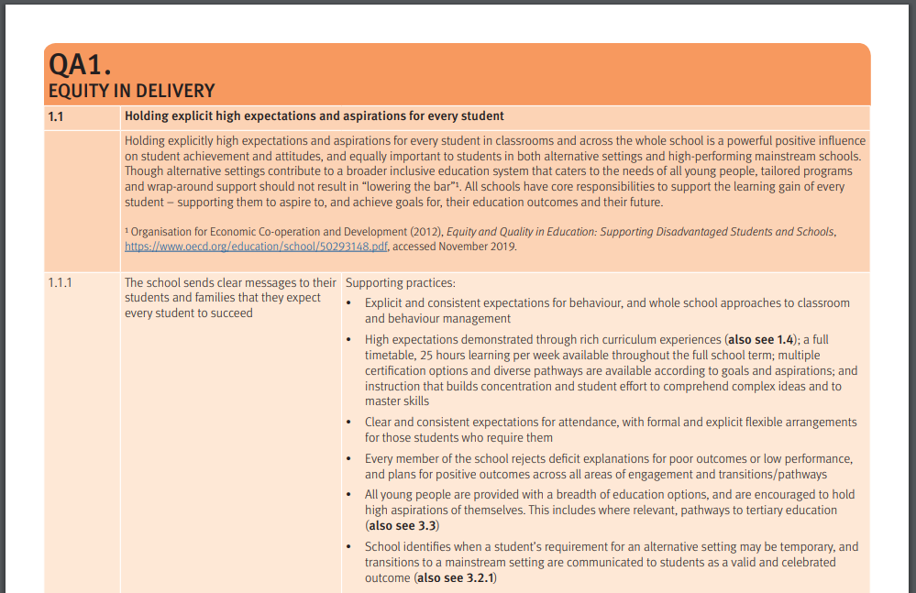
Quality alternative education
13 Standards that represent High Quality in alternative education settings, developed with the sector
advancingeducation.qld.gov.au/youthEngagement/Documents/summary-of-high-quality-practices.pdf

Slide 12
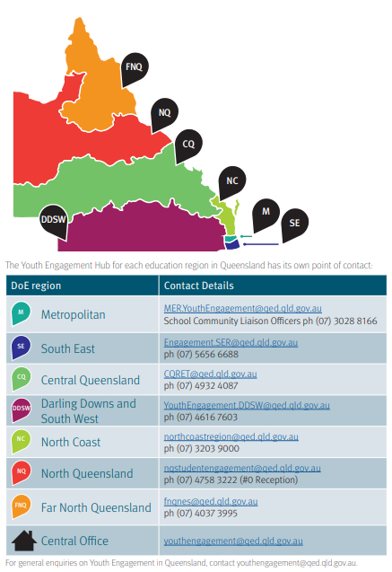
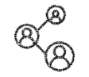
Regional Youth Engagement Hubs
In 2019 the Regional Youth Engagement Hubs:
Connected with and supported 4,490 young people
Successfully transitioned 2,721 young people
Continuing to case manage / support 1,416 young people
Connected with and supported 178 young people in the out-of-home-care system
Connected with and supported 431 young people in the youth justice system.
Connected with and supported 1,223 Indigenous young people
advancingeducation.qld.gov.au/youthEngagement/Documents/youth-engagement-hub-information-sheet.pdf

Slide 13
Eligibility:
Completed Year 12 in previous 2 years (some flexibility)
All young people who have completed their senior studies can join, irrespective of which school they attended
Current school students not eligible - career guidance and planning through schools
www.qld.gov.au/linkandlaunch

Slide 14
Link and Launch locations
Region | Current locations | Coming soon
Far North Queensland | Trinity Bay SHS | Woree SHS
North Queensland | Kirwan SHS Townsville SHS Northern Beaches SHS | Proserpine SHS
Central Queensland | Yeppoon SHS | Toolooa SHS
Darling Downs South West | Lockyer District SHS | Wilsonton SHS Nanango SHS
North Coast | Bundaberg SHS Clontarf Beach SHS | Morayfield SHS Urangan SHS
Metropolitan | Redbank Plains SHS Glenala SHS Bremer SHS | Lowood SHS
South East | Woodridge SHS Beaudesert SHS Marsden SHS | Beenleigh SHS Palm Beach-Currumbin SHS

